Slide 1

Headstart
Local Government Reform
Outline Proposal Overview
24/07/2026

Slide 2
Agenda
Open and introductions – Setting the scene
Background/recap
Headstart
  Criteria
  Backstop
West Coast process for headstart
Engagement report
Proposal
So now what?
Q & A 30 mins

Slide 3
Setting the scene
Welcome and introduction
The purpose of todays workshop is to:
  Answer questions, provide clarification and seek commentary on the outline proposal.
The purpose of todays workshop is not to:
  Debate if the Council wishes to proceed or not (that’s next weeks Council meeting)
Time is tight (total 1.5 hours) and this identical presentation is going to all West Coast Councils today and regional council on Tuesday 28th July.
Please note: There will not be an ability to change the proposal at the Council meetings when the Councils are choosing to adopt the proposal or not.

Slide 4
Background/recap
Resource Management Act (RMA) reform has been the primary catalyst for wider local government reform
The reform programme recognises that existing local government structures can be fragmented and duplicative,
The proposed replacement of the RMA significantly changes planning and resource management responsibilities,
Alongside planning reform, the Government has been advancing broader system initiatives, including Local Water Done Well, infrastructure funding reform, and City and Regional Deals, all aimed at improving service delivery and supporting regional growth
Government signalling has consistently focused on simpler, more efficient local government arrangements, with greater alignment between decision-making, infrastructure investment, environmental management, and community outcomes
All Four West Coast Councils have to date submitted on “Simplifying Local Government”, indicated a willingness to participate in current “Head Start process” and through the Mayors, Chairs and Iwi Forum and Council workshops guided the working group

Slide 5
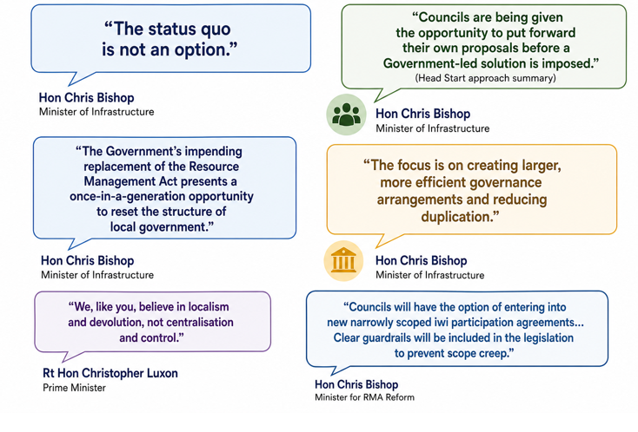
Headstart – current process
To accelerate reform and enable locally-led solutions, the Government introduced the ‘Head Start’ process, inviting councils to proactively develop proposals for future governance arrangements before a central government-led approach is considered

Slide 6
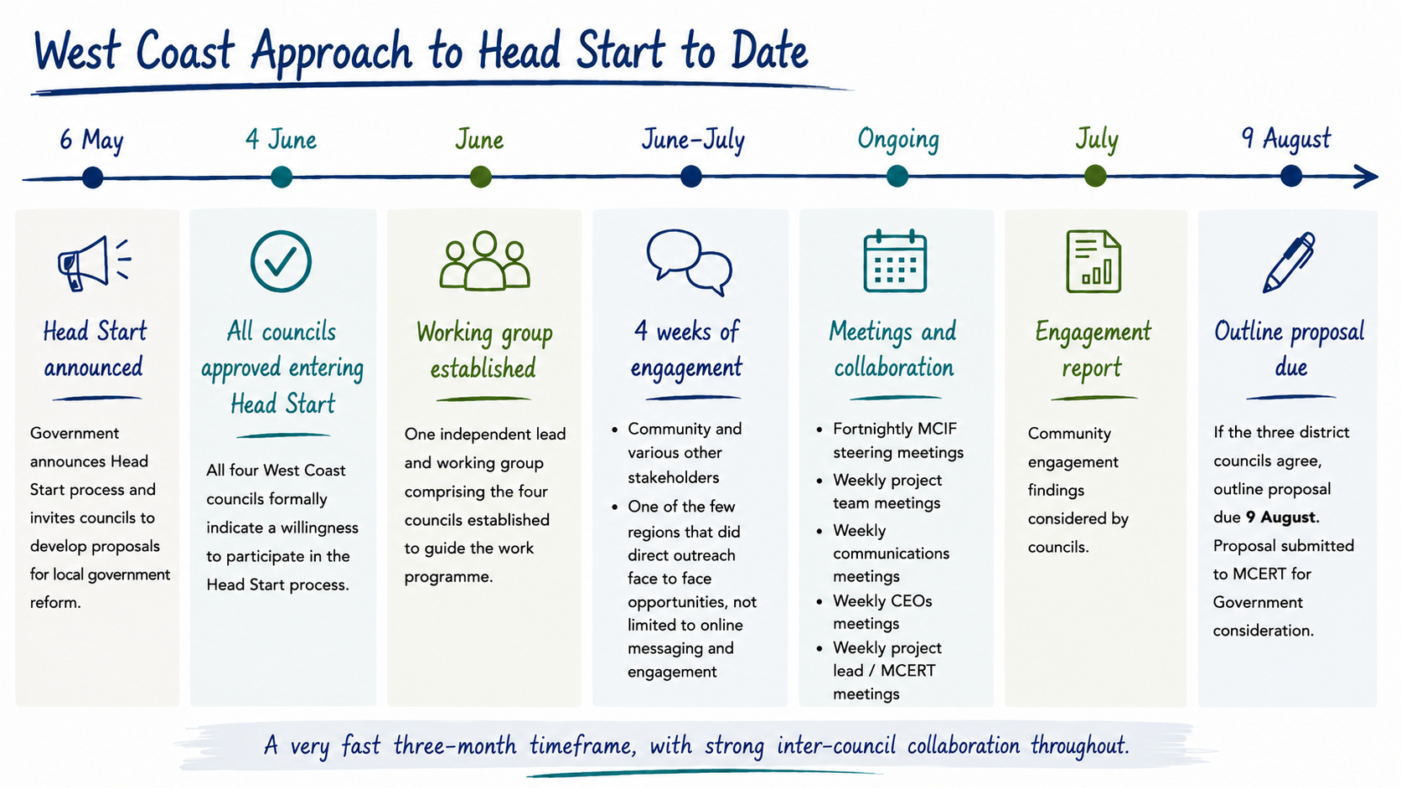

Slide 7
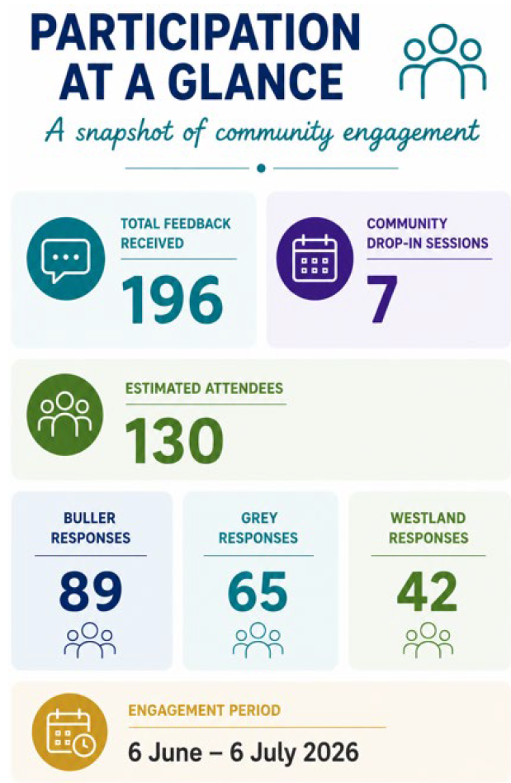
Engagement report

Slide 8
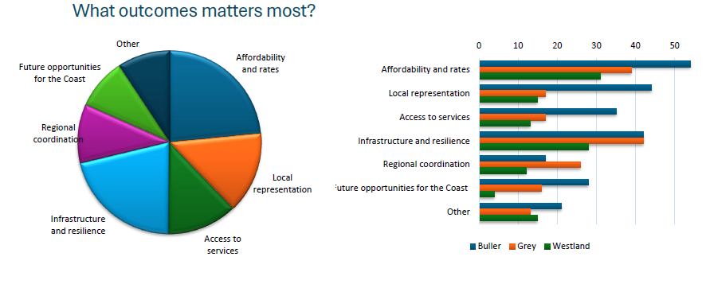
Engagement report

Slide 9
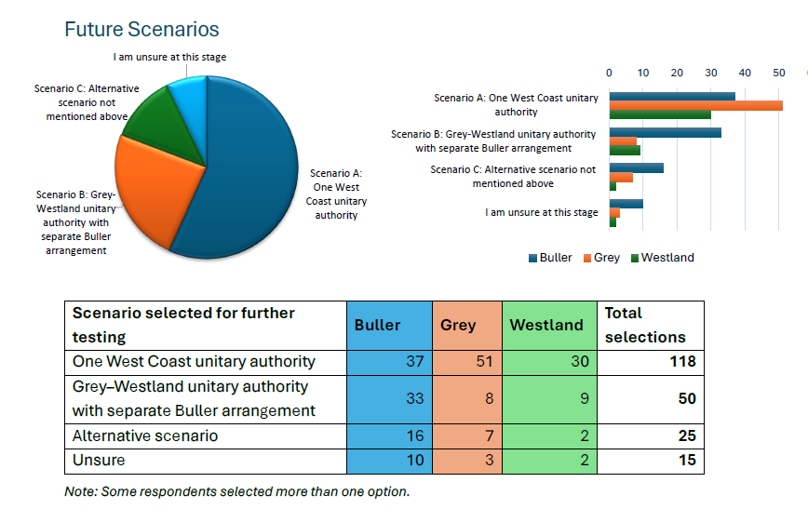
Engagement report

Slide 10
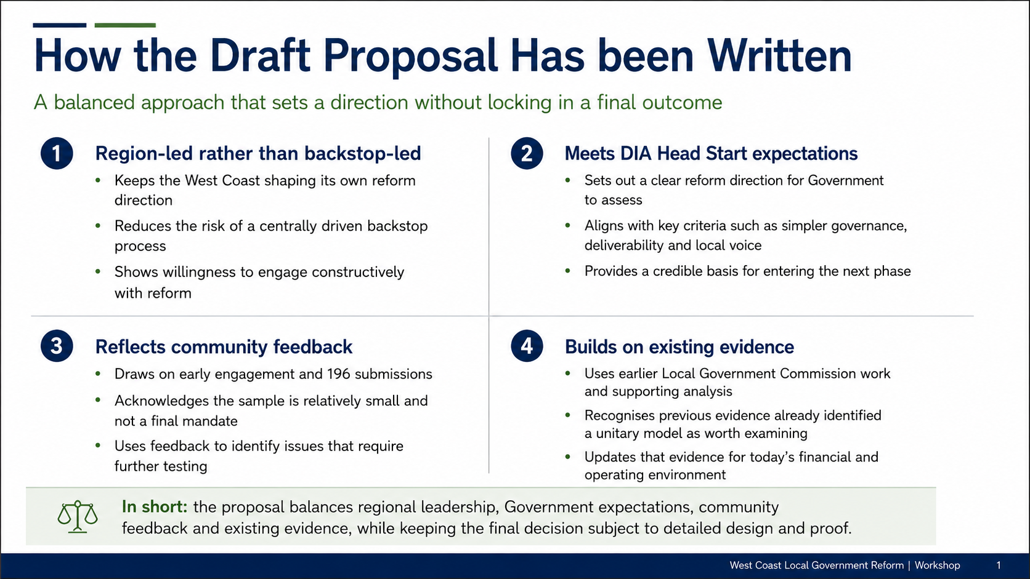
The Draft Proposal

Slide 11
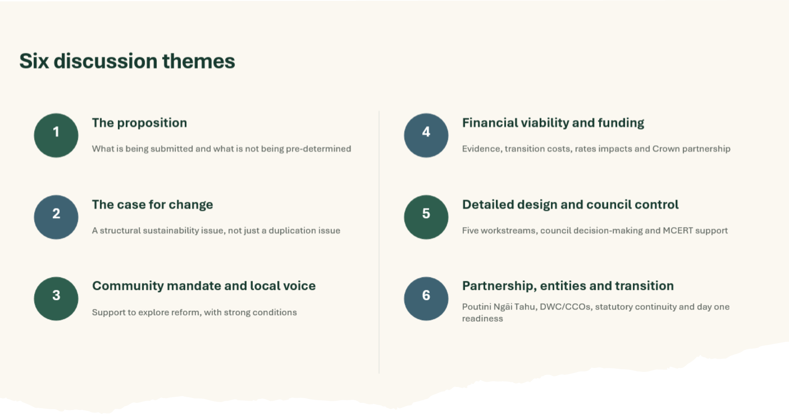

Slide 12
Theme 1: The proposition
The proposal is a gateway into detailed design — not a final decision.
“
FROM THE DRAFT PROPOSAL
“The proposal seeks Government support to progress a single West Coast unitary authority into detailed design under the Head Start pathway.”
“Progressing a single West Coast unitary authority into evidence gathering and detailed design would not constitute a final decision to establish that authority.”
1
High-level position
› Joint submission by Buller, Grey and Westland District Councils, with WCRC involved as an affected and supporting council.
› Evidence gathering will determine whether the model is viable and delivers better outcomes.
› If the model is not viable, councils would seek an alternative reform approach with Government.
3
4
1
Chapters: Eligibility | Evidence Base and Detailed Design | Where to From Here
submitting district
councils
affected
councils
model to
test

Slide 13
Theme 2: The case for change
The issue is sustainability, capability and funding — not amalgamation for its own sake.
“
FROM THE DRAFT PROPOSAL
“The West Coast faces a structural local government sustainability challenge.”
“The West Coast’s challenge is not duplication alone.”
2
Why change is being tested
› Fixed statutory and specialist functions are spread across a small population.
› A large conservation estate, visitor demand and natural hazards create costs not fully reflected in the rating base.
› Structural reform may improve scale and coordination, but sustainable funding remains critical.
34.7k
23.2k
86%
Chapters: Case for Change | Existing Evidence Base | Sustainable Long-Term Funding
population
rateable
properties
conservation
land

Slide 14
Theme 3: Community mandate and local voice
Engagement supports further investigation, with clear conditions around affordability and local voice.
“
FROM THE DRAFT PROPOSAL
“The initial engagement was designed as an early community conversation, not formal consultation on a model.”
“A strong local-board model would be a central component of the detailed design.”
3
What communities have put on the table
› Feedback supports further investigation, not a final mandate for one model.
› Affordability, infrastructure investment and visible local services are core community conditions.
› Local boards should have meaningful delegations, budgets and influence.
196
118
60%
Chapters: What We Heard from Communities | Local Voice Workstream | Head Start Criteria
survey
submissions
selected
Scenario A
of all
responses

Slide 15
Theme 4: Financial viability and funding
The next phase must prove net benefit and make the Crown funding conversation unavoidable.
“
FROM THE DRAFT PROPOSAL
“A new governance model may improve capability, coordination and efficiency, but it will not on its own resolve the mismatch between the region’s limited rating base and the scale of its infrastructure, resilience, environmental and regulatory responsibilities.”
“The West Coast seeks to work with Government on an enduring funding partnership.”
4
Financial tests
› Create a common financial baseline and independently model transition costs, rating impacts and benefits.
› Assess future revenue options including royalties, IVL, Regional Deal alignment and Crown co-investment.
› Treat financial viability as a gateway, not an assumption.
$6.1m
$2.8m
2027
Chapters: Existing Evidence Base | Sustainable Long-Term Funding | Annex Two | Financial Overview
historic transition
estimate
historic year-seven
efficiencies
new evidence
required

Slide 16
Theme 5: Detailed design and council control
The proposal asks for a council-led process, supported by independent evidence and MCERT capacity.
“
FROM THE DRAFT PROPOSAL
“The participating councils would lead the detailed-design process and retain all decisions on the structure and key features of the model.”
“MCERT would be requested to resource and coordinate the independent technical evidence, modelling and legislative support required.”
5
How the next phase works
› Five concurrent workstreams would run from September 2026 to March 2027.
› Councils set the design principles, test assumptions and make formal decisions.
› MCERT resources the evidence base, with community consultation before final council decisions.
5
6w
Mar 2027
Chapters: How the Region Has Approached Head Start | Evidence Base and Detailed Design | Annex One
workstreams
community
consultation
final council
decisions

Slide 17
Theme 6: Partnership, entities and transition
Reform must strengthen relationships, align regional entities and protect statutory delivery.
“
FROM THE DRAFT PROPOSAL
“Poutini Ngāi Tahu support progressing to the next phase provided detailed design is collaborative and existing partnership arrangements are used as an opportunity to be strengthened.”
“Continuity of essential services and statutory functions would be a core requirement of the detailed design and transition programme.”
6
Non-negotiables
› Use existing Poutini Ngāi Tahu partnership arrangements as a baseline to strengthen future arrangements.
› Assess the future relationship with Development West Coast, CCOs and regional entities.
› Protect statutory continuity (business as usual to continue)
Chapters: Poutini Ngāi Tahu Partnership | Regional Entities Workstream | Annex One Cross-Cutting Requirements

Slide 18
Now what?
Monday 3rd August – Three District Councils will decide to proceed into Head Start or enter Back Stop process
Tuesday 4th August – West Coast Regional Council will decide whether to submit a letter of support for the proposal.
There is a significant workload required for detailed design phase.
MCERT Officials will inform Councils of outcome as soon as practical including what support/resource can be provided by the Government.
If Councils choose to not adopt the proposal then backstop process will be put in place.

Slide 19
Open to Questions, clarifications and commentary on the Outline Proposal

